Slide 1
How WaveNet works?
<p> Ibragimova Alina. </p>

Slide 2
WaveNet - what is it?
<p> by DeepMind. </p>
Deep neural network for Text-to-Speech generation.
Has its own special approach for more real speech.

Slide 3
Approaches for creating Text-To-speech models
01

Slide 4
Two approaches
Concatenative Text-to-Speech
a very large database of short speech fragments
difficult to modify the voice
syllable assembly may sound choppy
Parametric TTS
the parameters of the model include all the information
the characteristics of the speech can be controlled
less natural

Slide 5
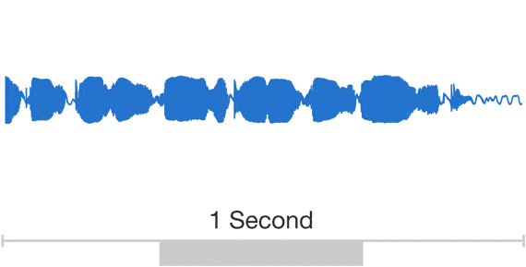
Approach of WaveNet
<p> Trained on human speech samples. </p>
Waveforms of speech patterns by predicting which sounds are most likely to follow each other.
Each built one sample at a time, with up to 24,000 samples per second of sound.
<p> Incorporates natural-sounding elements. </p>
Lip-smacking and breathing patterns.
Intonation, accents, emotion.
Changeable voice.

Slide 6
Inner structure of WaveNet
02

Slide 7

Structure of neural network
Convolutional neural network.
Circle = neuron.
A lot of neurons = layer.
3 types of layers: input, hidden, output.
Connection between neurons = synapse with weight.
Causal, autoregressive, dilated.

Slide 8
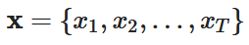
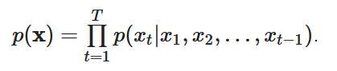
Predicting the next sound
Restore the probabilities of the sound signal:
Training time: the model estimates a given conditional probability distribution by accepting input signals from the training set.
Generating: the model generates output signals using the obtained probability distribution.
using conditional probabilities:

Slide 9
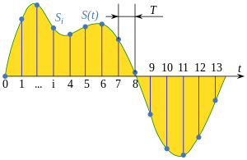
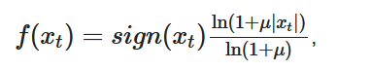
Vocoder algorithms
Sound wave signal / discretization
Mu-law
Encodes the signal as a two-digit hexadecimal number that represents some interval on the number line
Selects the value
Recovery formula

Slide 10
Sources
https://deepmind.google/discover/blog/wavenet-a-generative-model-for-raw-audio/
https://habr.com/ru/companies/Voximplant/articles/309648/
http://neerc.ifmo.ru/wiki/index.php?title=%D0%A1%D0%B8%D0%BD%D1%82%D0%B5%D0%B7_%D1%80%D0%B5%D1%87%D0%B8&mobileaction=toggle_view_desktop#WaveNet
https://www.researchgate.net/publication/340300352_Non-Parallel_Voice_Conversion_System_With_WaveNet_Vocoder_and_Collapsed_Speech_Suppression/figures?lo=1
Thank you for your attention!
Time for your questions

